Slide 1






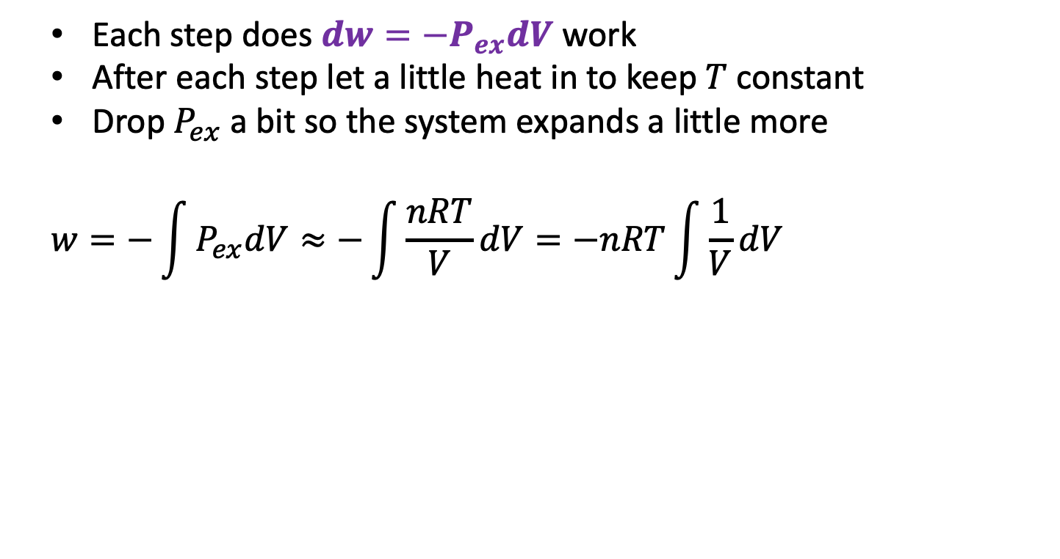


Last time: multistep isothermal expansion/contraction of an ideal gas
Each step does $dw=−P_{ex}dV$ work
After each step let a little heat in to keep $T$constant
Drop $P_{ex}$ a bit so the system expands a little more
$$w=−\int{P_{ex}dV≈−\int{\frac{nRT}{V}dV}=−nRT\int{\frac{1}{V}dV}}$$
$$P_{ex}$$
$$P_{ex}$$
$$P_{2},V_{2}$$
$$P_{1},V_{1}$$
$$P_{ex}$$
$$P_{Ideal}=nRT/V$$
$$V_{1}$$
$$V_{2}$$

Slide 2
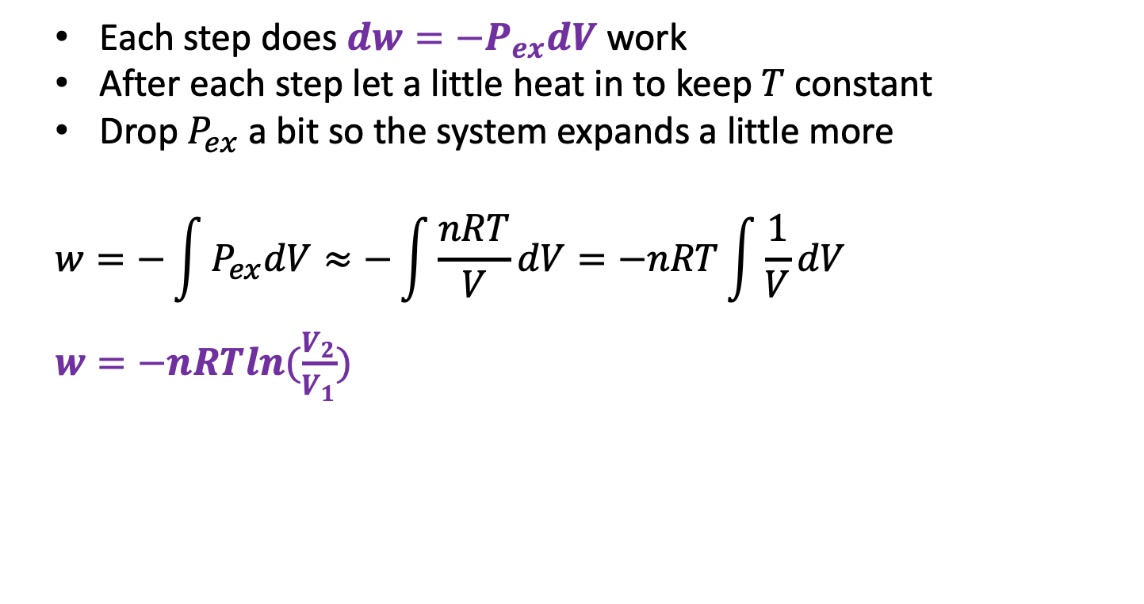
Here’s what we get after applying calculus
Each step does $dw=−P_{ex}dV$ work
After each step let a little heat in to keep $T$constant
Drop $P_{ex}$ a bit so the system expands a little more
$$w=−\int{P_{ex}dV≈−\int{\frac{nRT}{V}dV}=−nRT\int{\frac{1}{V}dV}}$$
$w=−nRTln(\frac{V_{2}}{V_{1}})$
$$P_{ex}$$
$$P_{ex}$$
$$P_{2},V_{2}$$
$$P_{1},V_{1}$$
$$P_{ex}$$
$$P_{Ideal}=nRT/V$$
$$V_{1}$$
$$V_{2}$$

Slide 3
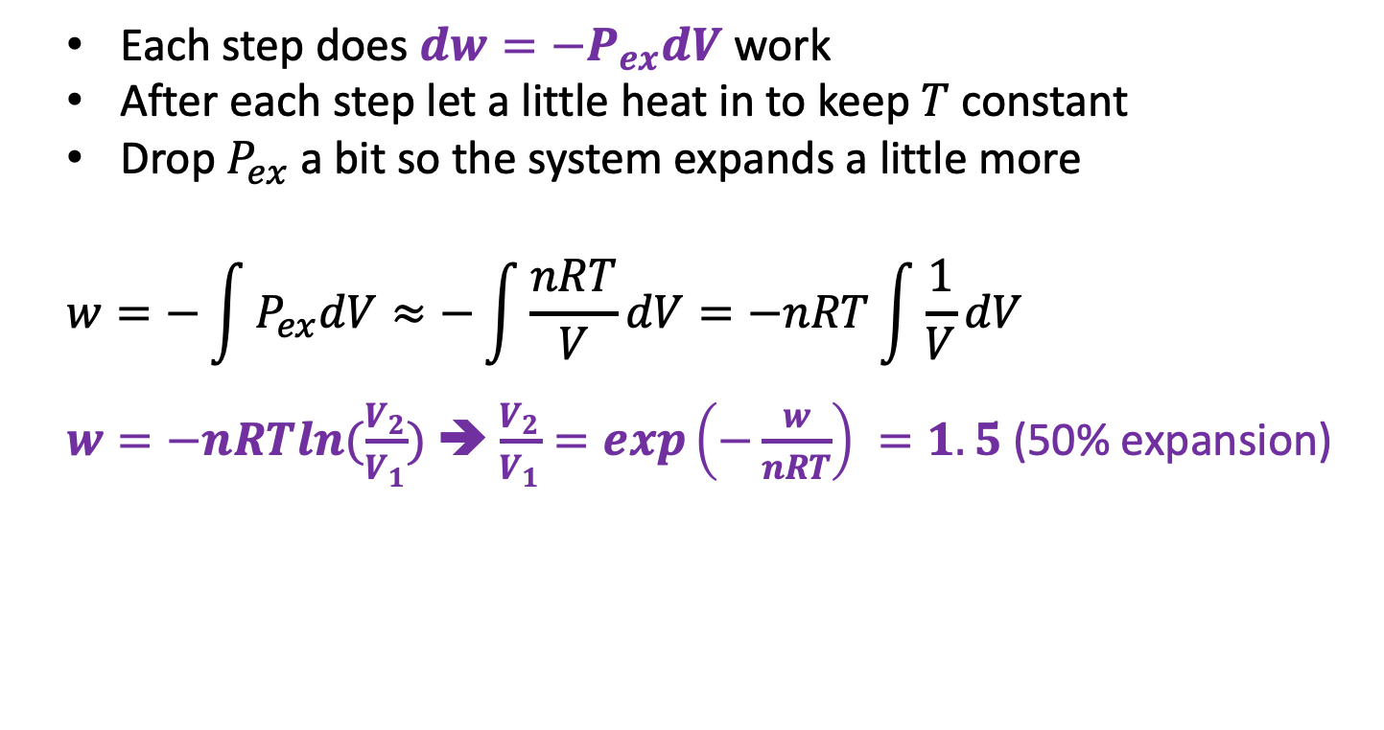
Here’s what we get after applying algebra (after the calculus)
Each step does $dw=−P_{ex}dV$ work
After each step let a little heat in to keep $T$constant
Drop $P_{ex}$ a bit so the system expands a little more
$$w=−\int{P_{ex}dV≈−\int{\frac{nRT}{V}dV}=−nRT\int{\frac{1}{V}dV}}$$
$w=−nRTln(\frac{V_{2}}{V_{1}})$ ➔ $\frac{V_{2}}{V_{1}}=exp\left(−\frac{w}{nRT}\right) =1.5$ (50% expansion)
$$P_{ex}$$
$$P_{ex}$$
$$P_{2},V_{2}$$
$$P_{1},V_{1}$$
$$P_{ex}$$
$$P_{Ideal}=nRT/V$$
$$V_{1}$$
$$V_{2}$$

Slide 4

Here’s what we get after applying the 1st Law (after the algebra and calculus)
We also know how much heat went in!
$$∆U=q+w$$
$w=−nRTln\left(\frac{V_{2}}{V_{1}}\right)$ (negative when expanding)
$q=+nRTln\left(\frac{V_{2}}{V_{1}}\right)$ (positive when expanding)
$$P_{ex}$$
$$P_{ex}$$
$$P_{2},V_{2}$$
$$P_{1},V_{1}$$
$$P_{ex}$$
$$P_{Ideal}=nRT/V$$
$$V_{1}$$
$$V_{2}$$

Slide 5
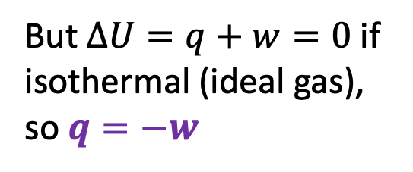

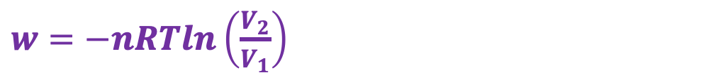

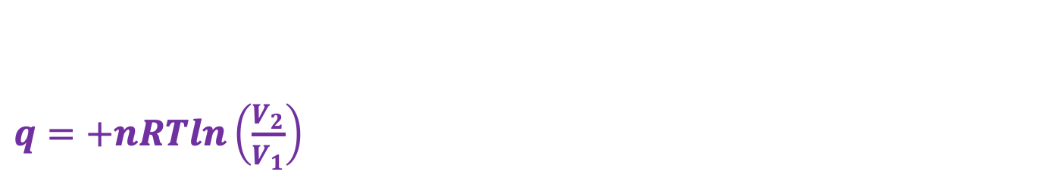



q for an isothermal expansion of an ideal gas
$$P_{ex}$$
$$P_{ex}$$
$$P_{ex}$$
$$P_{Ideal}=nRT/V$$
$$P_{2},V_{2}$$
$$P_{1},V_{1}$$
$$V_{1}$$
$$V_{2}$$
$q=+nRTln\left(\frac{V_{2}}{V_{1}}\right)$
$w=−nRTln\left(\frac{V_{2}}{V_{1}}\right)$
But $∆U=q+w=0$ if isothermal (ideal gas), so $q=−w$
$$U(T,V)$$
V
T

Slide 6
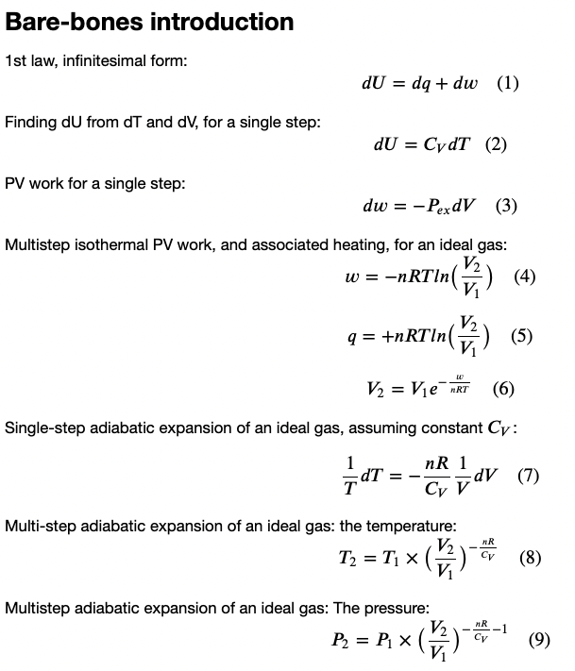
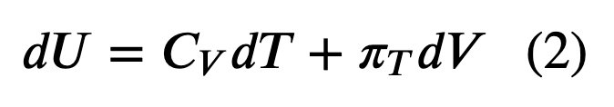
Here’s where we are so far

Slide 7


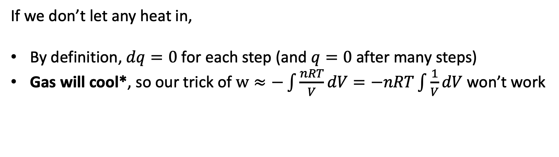
Next: we’ll do the expansion adiabatically
$$P_{ex}$$
$$V$$
If we don’t let any heat in,
By definition, $dq=0$ for each step (and $q=0$ after many steps)
Gas will cool*, so our trick of $w≈−\int{\frac{nRT}{V}dV}=−nRT\int{\frac{1}{V}dV}$ won’t work

Slide 8
*How we know the gas will cool: remember 1st day of Thermo?
When a molecule hits a receding wall, it bounces back more slowly.
Slower-moving molecules correspond to lower temperature.
$$P_{ex}$$
$$V$$

Slide 9

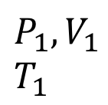
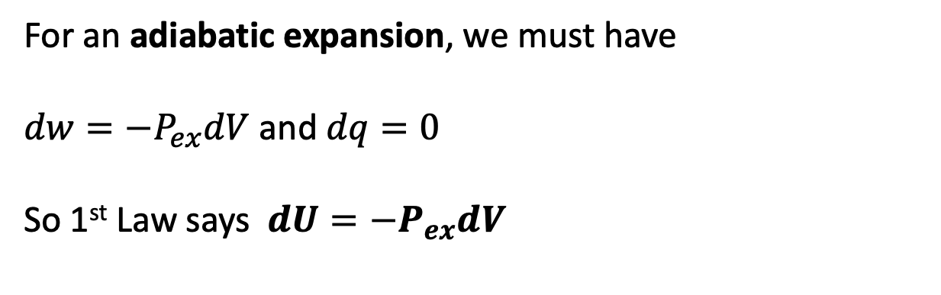






Single-step adiabatic expansion of an ideal gas
For an adiabatic expansion, we must have
$dw=−P_{ex}dV$ and $dq=0$
So 1st Law says $dU=−P_{ex}dV$
$$U(T,V)$$
V
$$P_{ex}$$
T
$$P_{ex}$$
$$P_{2},V_{2}$$
$$T_{2}$$
$$P_{1},V_{1}$$
$$T_{1}$$
$$P_{ex}$$
No heat going in/out
Temperature is going down
$$dV$$
$$V$$

Slide 10
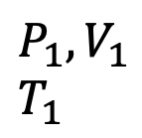
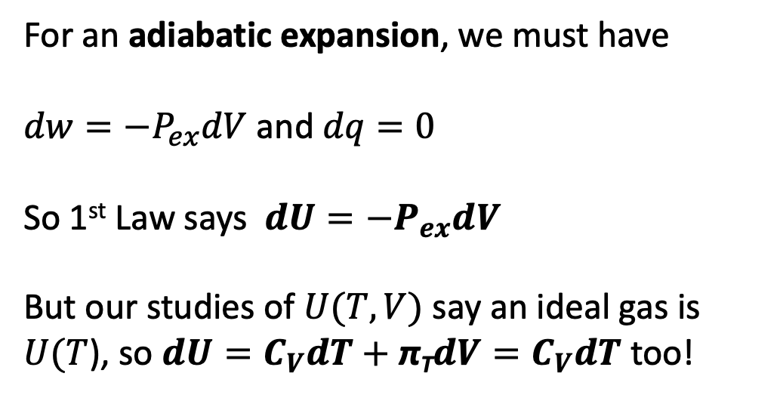

Single-step adiabatic expansion of an ideal gas
For an adiabatic expansion, we must have
$dw=−P_{ex}dV$ and $dq=0$
So 1st Law says $dU=−P_{ex}dV$
But our studies of $U(T,V)$ say an ideal gas is $U(T$), so $dU=C_{V}dT+$ π_{T}$dV=C_{V}dT$ too!
$$U(T,V)$$
V
$$P_{ex}$$
T
$$P_{ex}$$
$$P_{2},V_{2}$$
$$T_{2}$$
$$P_{1},V_{1}$$
$$T_{1}$$
$$P_{ex}$$
No heat going in/out
Temperature is going down
$$dV$$
$$V$$

Slide 11

Single-step adiabatic expansion of an ideal gas
For an adiabatic expansion, we must have
$dw=−P_{ex}dV$ and $dq=0$
So 1st Law says $dU=−P_{ex}dV$
But our studies of $U(T,V)$ say an ideal gas is $U(T$), so $dU=C_{V}dT+$ π_{T}$dV=C_{V}dT$ too!
Put them together!
$$−P_{ex}dV=C_{V}dT$$
Call it an ideal gas!
$$−\frac{nRT}{V}dV=C_{V}dT$$
$$U(T,V)$$
V
$$P_{ex}$$
T
$$P_{ex}$$
$$P_{2},V_{2}$$
$$T_{2}$$
$$P_{1},V_{1}$$
$$T_{1}$$
$$P_{ex}$$
No heat going in/out
Temperature is going down
$$dV$$
$$V$$

Slide 12

Single-step adiabatic expansion of an ideal gas
Solve for this:
$$\frac{1}{T}dT=…$$
$$U(T,V)$$
V
$$P_{ex}$$
T
$$P_{ex}$$
$$P_{2},V_{2}$$
$$T_{2}$$
$$P_{1},V_{1}$$
$$T_{1}$$
$$P_{ex}$$
No heat going in/out
Temperature is going down
$$dV$$
$$V$$

Slide 13

Single-step adiabatic expansion of an ideal gas
Solve for this:
$$\frac{1}{T}dT=−\frac{nR}{C_{V}} \frac{1}{V}dV$$
$$U(T,V)$$
V
$$P_{ex}$$
T
$$P_{ex}$$
$$P_{2},V_{2}$$
$$T_{2}$$
$$P_{1},V_{1}$$
$$T_{1}$$
$$P_{ex}$$
No heat going in/out
Temperature is going down
$$dV$$
$$V$$

Slide 14

Single-step adiabatic expansion of an ideal gas
Some interpretation …
$$\frac{1}{T}dT=−\frac{nR}{C_{V}} \frac{1}{V}dV$$
$\frac{1}{V}dV$ is the fractional change in volume. Multiply that by $−\frac{nR}{C_{V}}$ to get the fractional change in temperature! Works with % too.
$$U(T,V)$$
V
$$P_{ex}$$
T
$$P_{ex}$$
$$P_{2},V_{2}$$
$$T_{2}$$
$$P_{1},V_{1}$$
$$T_{1}$$
$$P_{ex}$$
No heat going in/out
Temperature is going down
$$dV$$
$$V$$

Slide 15

Single-step adiabatic expansion of an ideal gas
Example:
Say V increases from 10 -> 11 L
$\frac{1}{V}dV=0.1$ (or $10\%$)
If an ideal diatomic gas,
$\frac{nR}{C_{V}}=\frac{R}{\frac{7}{2}R}=\frac{2}{7}$
Then $\frac{1}{T}dT=−\frac{nR}{C_{V}} \frac{1}{V}dV$ says
$$\frac{1}{T}dT=−\frac{2}{7}×10\%=3\%$$
Like 300 K -> 291 K
$$U(T,V)$$
V
$$P_{ex}$$
T
$$P_{ex}$$
$$P_{2},V_{2}$$
$$T_{2}$$
$$P_{1},V_{1}$$
$$T_{1}$$
$$P_{ex}$$
No heat going in/out
Temperature is going down
$$dV$$
$$V$$

Slide 16


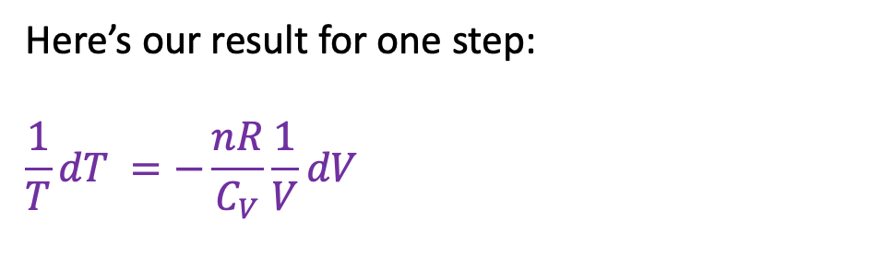


Multi-step adiabatic expansion of an ideal gas
Here’s our result for one step:
$$\frac{1}{T}dT =−\frac{nR}{C_{V}}\frac{1}{V}dV$$
$$U(T,V)$$
V
$$P_{ex}$$
T
$$P_{ex}$$
$$P_{2},V_{2}$$
$$T_{2}$$
$$P_{1},V_{1}$$
$$T_{1}$$
$$P_{ex}$$
No heat going in/out
Temperature is going down
$$P_{Ideal}=nRT/V$$
$$V_{1}$$
$$V_{2}$$

Slide 17

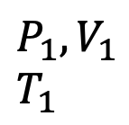



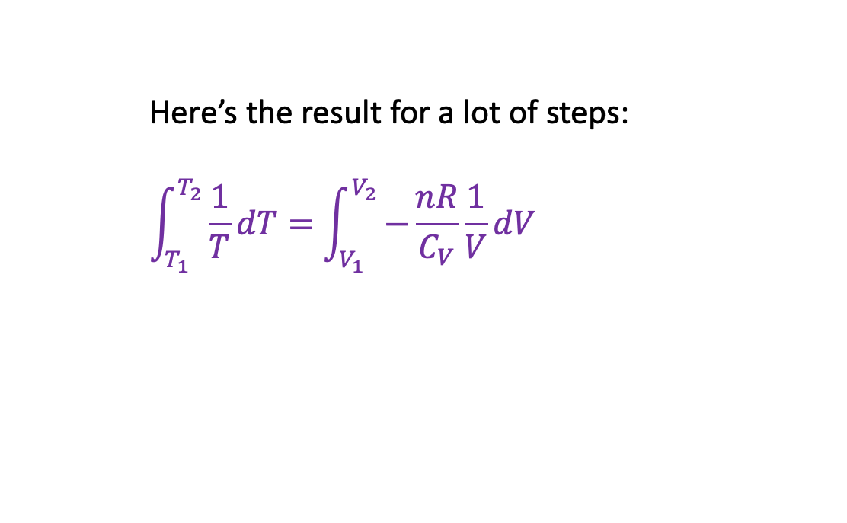




Multi-step adiabatic expansion of an ideal gas
Here’s the result for a lot of steps:
$$\int_{T_{1}}^{T_{2}}{\frac{1}{T}dT}=\int_{V_{1}}^{V_{2}}{−\frac{nR}{C_{V}}\frac{1}{V}dV}$$
$$U(T,V)$$
V
$$P_{ex}$$
T
$$P_{ex}$$
$$P_{2},V_{2}$$
$$T_{2}$$
$$P_{1},V_{1}$$
$$T_{1}$$
$$P_{ex}$$
No heat going in/out
Temperature is going down
$$P_{Ideal}=nRT/V$$
$$V_{1}$$
$$V_{2}$$

Slide 18
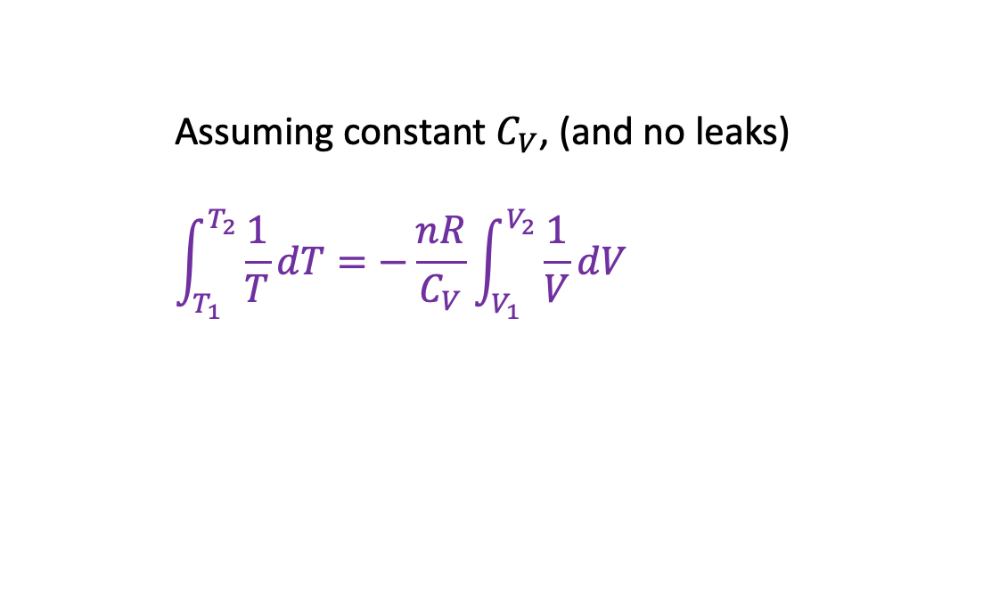
Multi-step adiabatic expansion of an ideal gas
Assuming constant $C_{V}$, (and no leaks)
$$\int_{T_{1}}^{T_{2}}{\frac{1}{T}dT}=−\frac{nR}{C_{V}}\int_{V_{1}}^{V_{2}}{\frac{1}{V}dV}$$
$$U(T,V)$$
V
$$P_{ex}$$
T
$$P_{ex}$$
$$P_{2},V_{2}$$
$$T_{2}$$
$$P_{1},V_{1}$$
$$T_{1}$$
$$P_{ex}$$
No heat going in/out
Temperature is going down
$$P_{Ideal}=nRT/V$$
$$V_{1}$$
$$V_{2}$$

Slide 19

Multi-step adiabatic expansion of an ideal gas
Here’s some calculus …
$$\int_{T_{1}}^{T_{2}}{\frac{1}{T}dT}=−\frac{nR}{C_{V}}\int_{V_{1}}^{V_{2}}{\frac{1}{V}dV}$$
$$U(T,V)$$
V
$$P_{ex}$$
T
$$P_{ex}$$
$$P_{2},V_{2}$$
$$T_{2}$$
$$P_{1},V_{1}$$
$$T_{1}$$
$$P_{ex}$$
No heat going in/out
Temperature is going down
$$P_{Ideal}=nRT/V$$
$$V_{1}$$
$$V_{2}$$

Slide 20
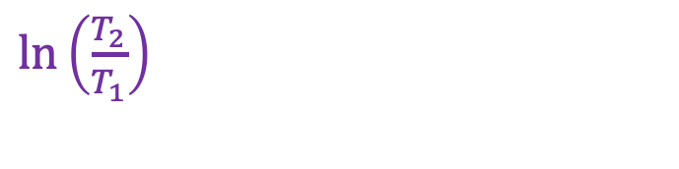
Multi-step adiabatic expansion of an ideal gas
Here’s some calculus …
$$\int_{T_{1}}^{T_{2}}{\frac{1}{T}dT}=−\frac{nR}{C_{V}}\int_{V_{1}}^{V_{2}}{\frac{1}{V}dV}$$
$$U(T,V)$$
V
$$P_{ex}$$
T
$$P_{ex}$$
$\ln\left(\frac{T_{2}}{T_{1}}\right)$
$$P_{2},V_{2}$$
$$T_{2}$$
$$P_{1},V_{1}$$
$$T_{1}$$
$$P_{ex}$$
No heat going in/out
Temperature is going down
$$P_{Ideal}=nRT/V$$
$$V_{1}$$
$$V_{2}$$

Slide 21

Multi-step adiabatic expansion of an ideal gas
Here’s some more calculus …
$$\int_{T_{1}}^{T_{2}}{\frac{1}{T}dT}=−\frac{nR}{C_{V}}\int_{V_{1}}^{V_{2}}{\frac{1}{V}dV}$$
$$U(T,V)$$
V
$$P_{ex}$$
T
$$P_{ex}$$
$\ln\left(\frac{T_{2}}{T_{1}}\right)$
$$P_{2},V_{2}$$
$$T_{2}$$
$$P_{1},V_{1}$$
$$T_{1}$$
$$P_{ex}$$
No heat going in/out
Temperature is going down
$$P_{Ideal}=nRT/V$$
$$V_{1}$$
$$V_{2}$$

Slide 22
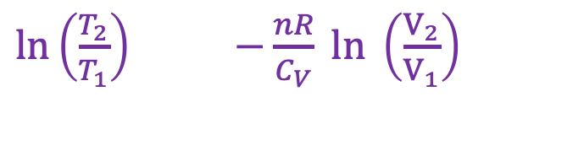
Multi-step adiabatic expansion of an ideal gas
Here’s some more calculus …
$$\int_{T_{1}}^{T_{2}}{\frac{1}{T}dT}=−\frac{nR}{C_{V}}\int_{V_{1}}^{V_{2}}{\frac{1}{V}dV}$$
$$U(T,V)$$
V
$$P_{ex}$$
T
$$P_{ex}$$
$\ln\left(\frac{T_{2}}{T_{1}}\right)$ $−\frac{nR}{C_{V}} ln \left(\frac{V_{2}}{V_{1}}\right)$
$$P_{2},V_{2}$$
$$T_{2}$$
$$P_{1},V_{1}$$
$$T_{1}$$
$$P_{ex}$$
No heat going in/out
Temperature is going down
$$P_{Ideal}=nRT/V$$
$$V_{1}$$
$$V_{2}$$

Slide 23
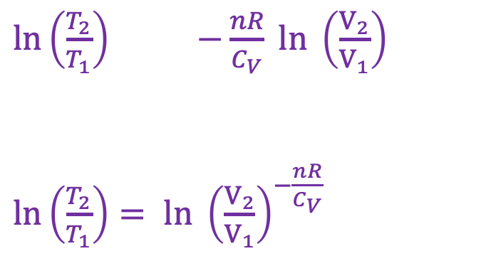

Multi-step adiabatic expansion of an ideal gas
Here’s a fancy log thing
$$\int_{T_{1}}^{T_{2}}{\frac{1}{T}dT}=−\frac{nR}{C_{V}}\int_{V_{1}}^{V_{2}}{\frac{1}{V}dV}$$
$$U(T,V)$$
V
$$P_{ex}$$
T
$$P_{ex}$$
$\ln\left(\frac{T_{2}}{T_{1}}\right)$ $−\frac{nR}{C_{V}} ln \left(\frac{V_{2}}{V_{1}}\right)$
$\ln\left(\frac{T_{2}}{T_{1}}\right)= ln {\left(\frac{V_{2}}{V_{1}}\right)}^{−\frac{nR}{C_{V}}}$
$$P_{2},V_{2}$$
$$T_{2}$$
$$P_{1},V_{1}$$
$$T_{1}$$
$$P_{ex}$$
No heat going in/out
Temperature is going down
$$P_{Ideal}=nRT/V$$
$$V_{1}$$
$$V_{2}$$

Slide 24
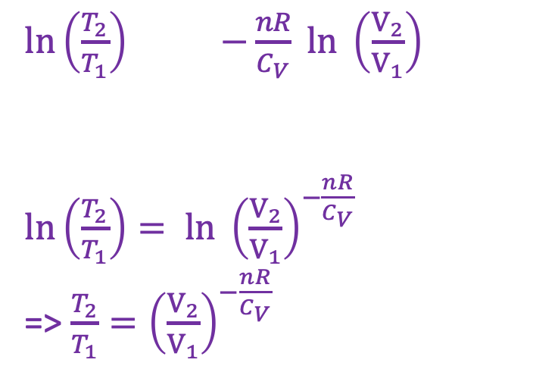

Multi-step adiabatic expansion of an ideal gas
Here’s some more algebra
$$\int_{T_{1}}^{T_{2}}{\frac{1}{T}dT}=−\frac{nR}{C_{V}}\int_{V_{1}}^{V_{2}}{\frac{1}{V}dV}$$
$$U(T,V)$$
V
$$P_{ex}$$
T
$$P_{ex}$$
$\ln\left(\frac{T_{2}}{T_{1}}\right)$ $−\frac{nR}{C_{V}} ln \left(\frac{V_{2}}{V_{1}}\right)$
$\ln\left(\frac{T_{2}}{T_{1}}\right)= ln {\left(\frac{V_{2}}{V_{1}}\right)}^{−\frac{nR}{C_{V}}}$
=> $\frac{T_{2}}{T_{1}}={\left(\frac{V_{2}}{V_{1}}\right)}^{−\frac{nR}{C_{V}}}$
$$P_{2},V_{2}$$
$$T_{2}$$
$$P_{1},V_{1}$$
$$T_{1}$$
$$P_{ex}$$
No heat going in/out
Temperature is going down
$$P_{Ideal}=nRT/V$$
$$V_{1}$$
$$V_{2}$$

Slide 25
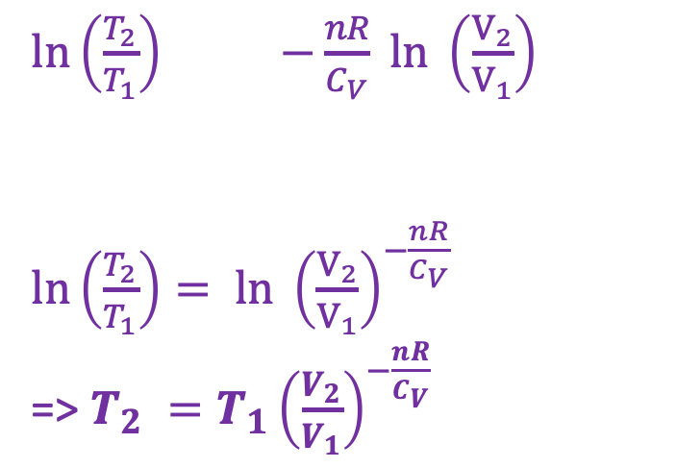

Multi-step adiabatic expansion of an ideal gas
We are just so clever
$$\int_{T_{1}}^{T_{2}}{\frac{1}{T}dT}=−\frac{nR}{C_{V}}\int_{V_{1}}^{V_{2}}{\frac{1}{V}dV}$$
$$U(T,V)$$
V
$$P_{ex}$$
T
$$P_{ex}$$
$\ln\left(\frac{T_{2}}{T_{1}}\right)$ $−\frac{nR}{C_{V}} ln \left(\frac{V_{2}}{V_{1}}\right)$
$\ln\left(\frac{T_{2}}{T_{1}}\right)= ln {\left(\frac{V_{2}}{V_{1}}\right)}^{−\frac{nR}{C_{V}}}$
=> $T_{2} ={T_{1}\left(\frac{V_{2}}{V_{1}}\right)}^{−\frac{nR}{C_{V}}}$
$$P_{2},V_{2}$$
$$T_{2}$$
$$P_{1},V_{1}$$
$$T_{1}$$
$$P_{ex}$$
No heat going in/out
Temperature is going down
$$P_{Ideal}=nRT/V$$
$$V_{1}$$
$$V_{2}$$

Slide 26

Multi-step adiabatic expansion of an ideal gas
Before, we said V increased from 10 -> 11 L. That was small enough to justify the use of the pre-integrated form
$$\frac{1}{T}dT=−\frac{nR}{C_{V}} \frac{1}{V}dV$$
Now, let’s say 10 -> 20 L, which is too much of a change big to use the above. Instead we have to use
$$T_{2} ={T_{1}\left(\frac{V_{2}}{V_{1}}\right)}^{−\frac{nR}{C_{V}}}$$
$$U(T,V)$$
V
$$P_{ex}$$
T
$$P_{ex}$$
$$P_{2},V_{2}$$
$$T_{2}$$
$$P_{1},V_{1}$$
$$T_{1}$$
$$P_{ex}$$
No heat going in/out
Temperature is going down
$$P_{Ideal}=nRT/V$$
$$V_{1}$$
$$V_{2}$$

Slide 27

Multi-step adiabatic expansion of an ideal gas
$$U(T,V)$$
$\frac{V_{2}}{V_{1}}=\frac{20}{10}=2$
$\frac{nR}{C_{V}}=\frac{2}{7}$
$T_{2}=T_{1} {\left(2\right)}^{−\frac{2}{7}}=T_{1} × 0.8$
V
$$P_{ex}$$
T
$$P_{ex}$$
$$P_{2},V_{2}$$
$$T_{2}$$
$$P_{1},V_{1}$$
$$T_{1}$$
$$P_{ex}$$
No heat going in/out
Temperature is going down
$$P_{Ideal}=nRT/V$$
$$V_{1}$$
$$V_{2}$$

Slide 28

Multi-step adiabatic expansion of an ideal gas
$$U(T,V)$$
$\frac{V_{2}}{V_{1}}=\frac{20}{10}=2$
$\frac{nR}{C_{V}}=\frac{2}{7}$
$$T_{2}=T_{1} {\left(2\right)}^{−\frac{2}{7}}=T_{1} × 0.8=300 × 0.8$$
V
$$P_{ex}$$
T
$$P_{ex}$$
$$P_{2},V_{2}$$
$$T_{2}$$
$$P_{1},V_{1}$$
$$T_{1}$$
$$P_{ex}$$
No heat going in/out
Temperature is going down
$$P_{Ideal}=nRT/V$$
$$V_{1}$$
$$V_{2}$$

Slide 29

Multi-step adiabatic expansion of an ideal gas
$$U(T,V)$$
$\frac{V_{2}}{V_{1}}=\frac{20}{10}=2$
$\frac{nR}{C_{V}}=\frac{2}{7}$
$$T_{2}=T_{1} {\left(2\right)}^{−\frac{2}{7}}=T_{1} × 0.8=300 × 0.8=240 K$$
V
$$P_{ex}$$
T
$$P_{ex}$$
$$P_{2},V_{2}$$
$$T_{2}$$
$$P_{1},V_{1}$$
$$T_{1}$$
$$P_{ex}$$
No heat going in/out
Temperature is going down
$$P_{Ideal}=nRT/V$$
$$V_{1}$$
$$V_{2}$$

Slide 30
We’ll practice all this on Thursday and Friday

